Slide 1
Compilation of Industrial Production Index

Slide 2
Overview of Steps
Data collection & Scrutiny
Compilation
Dissemination

Slide 3
Data Collection
After Collection of back series data for base year 2022 and 2025
Data for two periods are to be collected from the factories/ establishments
For the reference month (quick estimate) within 10th of the monthllowing the reference month; and
For the month previous to the reference month for final revised estimate of the previous month.
If an establishment fails to provide production data for a month by the stipulated timeframe, the data for the month has to be estimated
Use one of the three simple methods:
Repeat previous month’s production
Average of last three month’s production
Repeat previous year’s corresponding month’s production

Slide 4
Data Collection
Illustration of data received from establishments
Establishment | Product (HS 8Digit) | Unit | Jan-22 | Feb-22
E1 | 21069099 | Kg | 450 | 430
E2 | 21069099 | Kg | 200 | 250
E3 | 24031100 | Ltr | 750 | 800
E4 | 24031100 | Ltr | 800 | 930
E5 | 24031100 | Ltr | 400 | 350
E6 | 28010000 | Number | 1500 | 1200
E7 | 28010000 | Number | 250 | 350
E8 | 28010000 | Number | 1200 | 1100
E9 | 28010000 | Number | 650 | 750
E10 | 32149000 | Meter | 900 | 850
E11 | 32149000 | Meter | 300 | 320
E12 | 33030010 | Meter | 550 | 530
E13 | 33030010 | Meter | 200 | 170
E14 | 33030010 | Meter | 400 | 380
E15 | 39172100 | Number | 1800 | 1700

Slide 5
Data Collection
The establishment level data is then aggregated to get the product/ item level data. Same products are added .
Establishment | Product (HS 8Digit) | Unit | Jan-25 | Jan-25 | Feb-25 | Feb-25
E1 | 21069099 | Kg | 450 | 650 | 430 | 680
E2 | 21069099 | Kg | 200 |  | 250
E3 | 24031100 | Ltr | 750 | 1950 | 800 | 2080
E4 | 24031100 | Ltr | 800 |  | 930
E5 | 24031100 | Ltr | 400 |  | 350
E6 | 28010000 | Number | 1500 | 3600 | 1200 | 3400
E7 | 28010000 | Number | 250 |  | 350
E8 | 28010000 | Number | 1200 |  | 1100
E9 | 28010000 | Number | 650 |  | 750
E10 | 32149000 | Meter | 900 | 2350 | 850 | 2250
E11 | 32149000 | Meter | 300 |  | 320
E12 | 33030010 | Meter | 550 |  | 530
E13 | 33030010 | Meter | 200 |  | 170
E14 | 33030010 | Meter | 400 |  | 380
E15 | 39172100 | Number | 1800 | 1800 | 1700 | 1700

Slide 6
Data Scrutiny
Data collected have to be scrutinized as per well defined scrutiny points:
In addition to standard validation checks ( hard & soft) in-built in the data collection portal/mechanism, the additional scrutiny points have to be developed based on the back series data collected since January 2022

Slide 7
Compilation
The indices of IPI are compiled using a bottom-up approach
Item Level
ISIC 4-Digit
ISIC 3-Digit
ISIC 2-Digit
Manufacturing Sector IPI

Slide 8
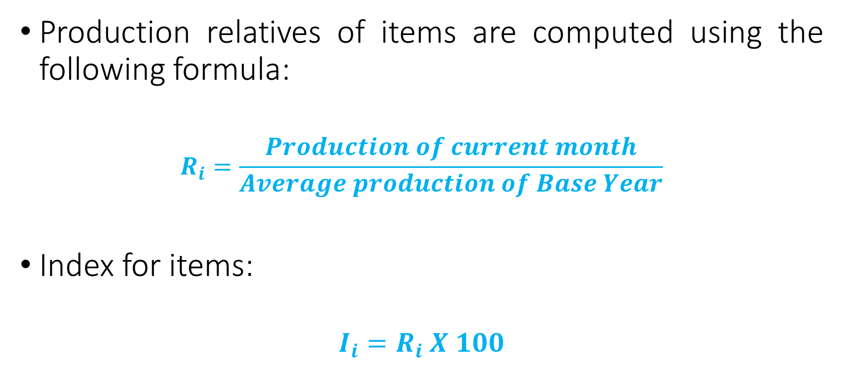
Compilation
Step 1: Indices at item level
Production relatives of items are computed using the following formula:
$$R_{i}=\frac{Production of current month}{Average production of Base Year}$$
Index for items:
$$I_{i}=R_{i} X 100$$

Slide 9
Compilation
Step 1: Indices at item level
Illustration: Calculation of Average ( A.M.) Base Year Production
Product (HS 8Digit) | Unit | Jan-22 | Feb-22 | Mar-22 | Apr-22 | May-22 | Jun-22 | Jul-22 | Aug-22 | Sep-22 | Oct-22 | Nov-22 | Dec-22 | Avg. BY Production
21069099 | Kg | 650 | 680 | 750 | 730 | 690 | 550 | 850 | 880 | 780 | 720 | 680 | 710 | 722.5

Slide 10
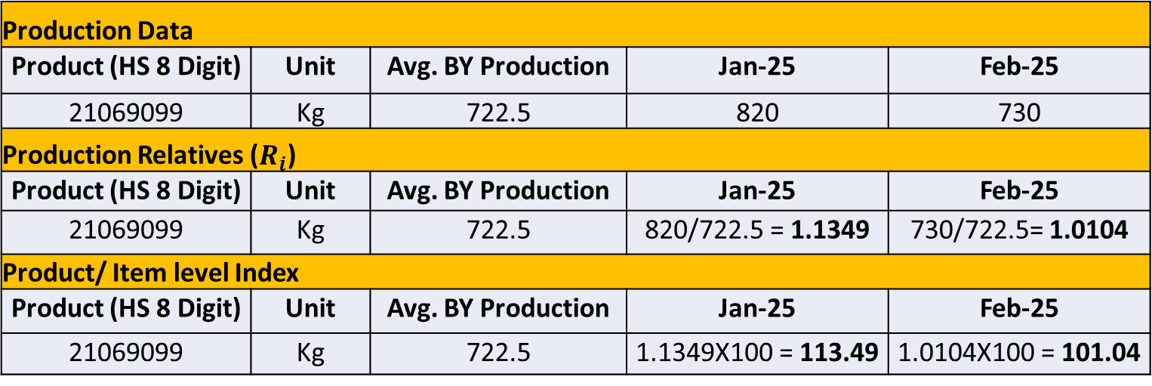
Compilation
Step 1: Indices at item level
Illustration: Calculation of Item Level Indices
Production Data
Product (HS 8 Digit) | Unit | Avg. Base Year (BY) Production | Jan-25 | Feb-25
21069099 | Kg | 722.5 | 820 | 730
Product (HS 8 Digit) | Unit | Avg. BY Production | Jan-25 | Feb-25
21069099 | Kg | 722.5 | 820/722.5 = 1.1349 | 730/722.5= 1.0104
Product/ Item level Index
Product (HS 8 Digit) | Unit | Avg. BY Production | Jan-25 (I) | Feb-25(I)
21069099 | Kg | 722.5 | 1.1349X100 = 113.49 | 1.0104X100 = 101.04

Slide 11
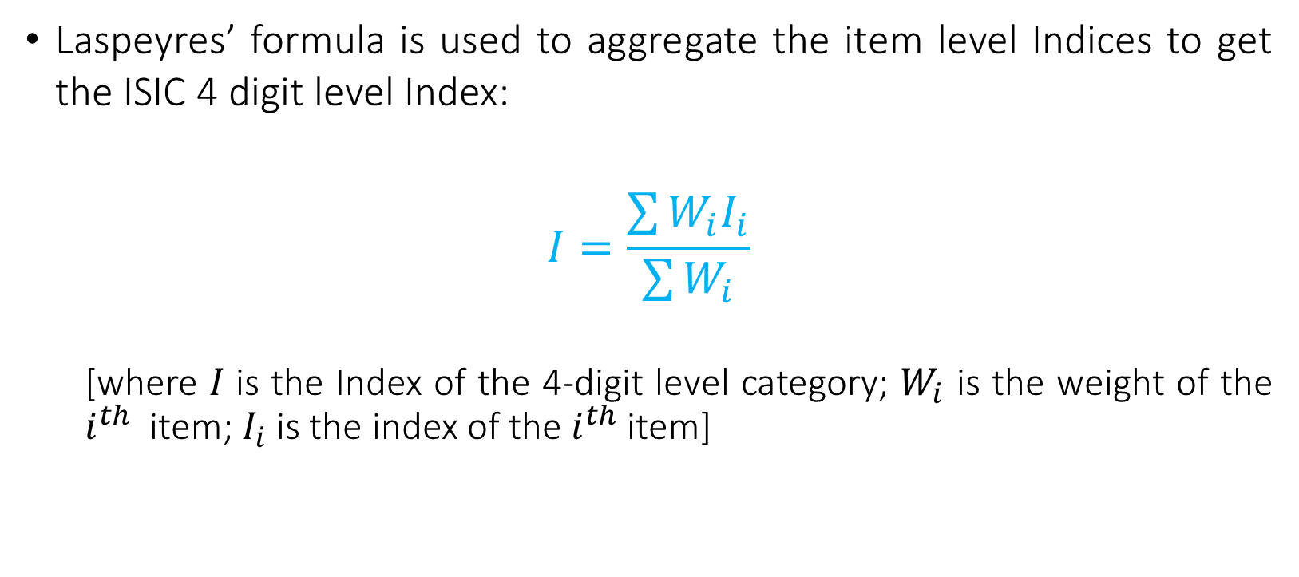
Compilation
Step 2: Aggregation of Item level Indices
Laspeyres’ formula is used to aggregate the item level Indices to get the ISIC 4 digit level Index:
$$I=\frac{\sum{W_{i}I_{i}}}{\sum{W_{i}}}$$
[where 𝐼 is the Index of the 4-digit level category; $W_{i}$ is the weight of the $i^{th}$ item; $I_{i}$is the index of the $i^{th}$item]

Slide 12
Compilation
Step 1: Indices at ISIC 4-Digit level
Illustration: Aggregation of Item Level Indices
ISIC 4 Digit | Product (HS 8 Digit) | Weight as in IB | Item level Indices
1010 | 16029010 | 8.5 | 102.24
1010 | 16010030 | 10.8 | 132.50
1050 | 20091210 | 11.5 | 113.78
1061 | 10051000 | 14.0 | 120.32
1061 | 08021200 | 7.0 | 98.75
1061 | 10011100 | 8.5 | 107.80
1399 | 42050020 | 9.7 | 117.65
1392 | 66011000 | 8.0 | 125.50
1410 | 62034200 | 10.5 | 115.25
1410 | 62104000 | 11.5 | 118.60
ISIC 4 Digit | Calculation of ISIC 4 Digit Weights | ISIC 4 Digit Weights | Calculation of ISIC 4 Digit Indices | ISIC 4 Digit Indices
1010 | 8.5+10.8 | 19.3 | ((102.24*8.5)+(132.50*10.8))/19.3 | 119.17
1050 | 11.5 | 11.5 | 113.78*11.5/11.5 | 113.78
1061 | 14.0+7.0+8.5 | 29.5 | ((120.32*14.0)+(98.75*7.0)+(107.8*8.5))/29.5 | 111.59
1399 | 9.7 | 9.7 | 117.65*9.7/9.7 | 117.65
1392 | 8.0 | 8.0 | 125.5*8.0/8.0 | 125.50
1410 | 10.5+11.5 | 22.0 | ((115.25*10.5)+(118.6*11.5))/22.0 | 117.00

Slide 13
Compilation
Step 3: Aggregation of Indices
Laspeyres’ formula is also used to compile ISIC 3 Digit level indices from the ISIC 4 Digit level indices
ISIC 4 Digit | ISIC 4 Digit Weights | ISIC 4 Digit Indices
1010 | 19.3 | 119.17
1050 | 11.5 | 113.78
1061 | 29.5 | 111.59
1399 | 9.7 | 117.65
1392 | 8.0 | 125.50
1410 | 22.0 | 117.00
ISIC 3 Digit | Calculation of ISIC 3 Digit Weights | ISIC 3 Digit Weights | Calculation of ISIC 3 Digit Indices | ISIC 3 Digit Indices
101 | 19.3 | 19.3 | 119.17*19.3/19.3 | 119.17
105 | 11.5 | 11.5 | 113.78*11.5/11.5 | 113.78
106 | 29.5 | 29.5 | 111.59*29.5/29.5 | 111.59
139 | 9.7+8.0 | 17.7 | ((117.65*9.7)+(125.50*8.0))/17.7 | 121.20
141 | 22.0 | 22.0 | 117.00*22.0/22.0 | 117.00

Slide 14
Compilation
Step 3: Aggregation of Indices
Laspeyres’ formula is also used to compile ISIC 2 Digit level indices from the ISIC 3 Digit level indices
ISIC 3 Digit | ISIC 3 Digit Weights | ISIC 3 Digit Indices
101 | 19.3 | 119.17
105 | 11.5 | 113.78
106 | 29.5 | 111.59
139 | 17.7 | 121.20
141 | 22.0 | 117.00
ISIC 2 Digit | Calculation of ISIC 2 Digit Weights | ISIC 2 Digit Weights | Calculation of ISIC 2 Digit Indices | ISIC 2 Digit Indices
10 | 19.3+11.5+29.5 | 60.3 | ((119.17*19.3)+(113.78*11.5)+(111.59*29.5))/60.3 | 114.43
13 | 17.7 | 17.7 | 121.20*17.7/17.7 | 121.20
14 | 22.0 | 22.0 | 117.00*22.0/22.0 | 117.00

Slide 15
Compilation
Step 3: Aggregation of Indices
Manufacturing sector IPI compiled by aggregating ISIC 2 Digit Indices using Laspeyres’ formula
ISIC 2 Digit | ISIC 2 Digit Weights | ISIC 2 Digit Indices
10 | 60.3 | 114.43
13 | 17.7 | 121.20
14 | 22.0 | 117.00
 | Weight | Calculation of Manufacturing IPI | Manufacturing IPI Index
Manufacturing IPI | 100.0 | ((114.43*60.3)+(121.20*17.7)+(117.00*22.0))/100 | 116.19

Slide 16
Compilation
Step 5: Growth Rates
Calculation of Year on Year (Y-o-Y) growth rates
The growth rates of IPI are calculated by comparing the indices of the current month with the indices of the same period of the previous year
An illustration of calculation of growth rates is given below
Manufacturing IPI |  | Calculation of Growth Rate | Growth Rate (in %)
Jan-24 | Jan-25
125.4 | 133.6 | ((133.6-125.4) / 125.4)*100 | 6.54

Slide 17
Dissemination
Monthly indices along with their growth rates (y-o-y)
Manufacturing Sector IPI
ISIC 2 digit level
Regular release
Must be released at a fixed interval – preferably at a predeclared date
Released in public domain

